Slide 1
Intro to RDBMS and SQL
ISTA 322 - Data Engineering

Slide 2
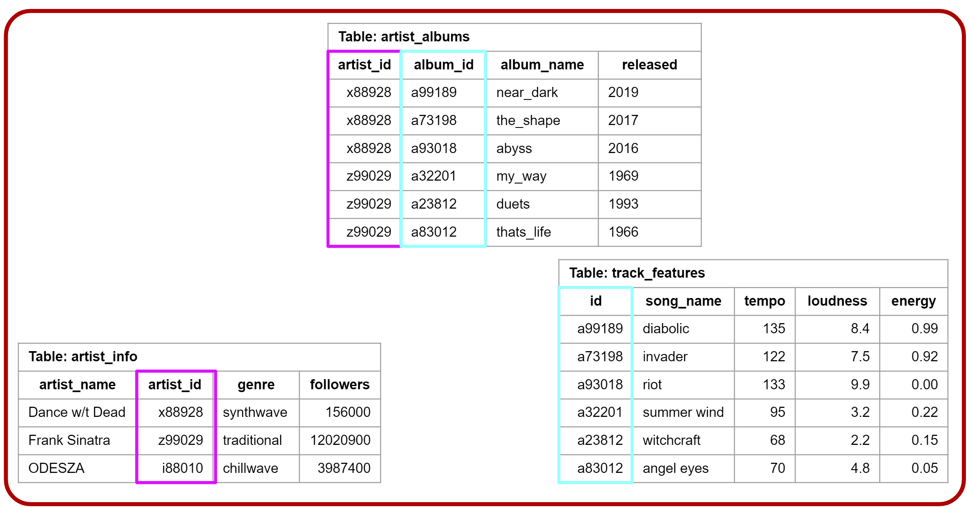
Working with a RDBMS Connect to RDBMS
RDB on AWS/local/server
To connect need credentials
Name
Host (location)
Username
Password
DB Manger controls acces, etc.
connection
Your computer

Slide 3
Working with a RDBMS Create cursor
RDB on AWS/local/server
Cursor allocates memory at the RDB
Memory allocation
connection
cursor
Your computer

Slide 4
Working with a RDBMS Fetch data using cursor
RDB on AWS/local/server
Cursor allocates memory at the RDB
Cursor object executes query
Memory allocation
connection
cursor
Your computer

Slide 5
Working with a RDBMS Fetch data using cursor
RDB on AWS/local/server
Cursor allocates memory at the RDB
Cursor object executes query
Cursor used to fetch results which are then displayed or stored locally
Memory allocation
connection
cursor
Your computer

Slide 6
Working with a RDBMS
RDB on AWS/local/server
It’s important to not leave connections and cursors open
Your functions should close them at the end!
connection
cursor
Your computer

Slide 7
SQL Syntax
After getting your connection and cursor you can write a query
Query is the statement of actions that you want to perform
SELECT, FROM, WHERE, GROUPBY...

Slide 8
Syntactical Order of Operations
SELECT
DISTINCT
AGGREGATIONS
FROM
JOIN
WHERE
GROUP BY
HAVING
ORDER BY
Starting with the basics

Slide 9
Syntactical Order of Operations
SELECT
SELECT
DISTINCT
AGGREGATIONS
FROM
JOIN
WHERE
GROUP BY
HAVING
ORDER BY
SELECT - Select the columns you want from a table
Call columns by names
Or call all using *
SELECT song_name, artist_id

Slide 10
SELECT
Table: top_track_features
artist_id | song_name | tempo | loudness | energy
x88928 | diabolic | 135 | 8.4 | 0.99
x88928 | invader | 122 | 7.5 | 0.92
x88928 | riot | 133 | 9.9 | 0.00
z99029 | summer wind | 95 | 3.2 | 0.22
z99029 | witchcraft | 68 | 2.2 | 0.15
z99029 | angel eyes | 70 | 4.8 | 0.05
SELECT - Select the columns you want from a table
Call columns by names
Or call all using *
SELECT song_name, artist_id

Slide 11
Syntactical Order of Operations
FROM
SELECT
DISTINCT
AGGREGATIONS
FROM
JOIN
WHERE
GROUP BY
HAVING
ORDER BY
FROM - What table do you want the columns from?
Obviously weird to call this second… more on this later.
SELECT song_name, artist_id
FROM top_track_features

Slide 12
FROM
Table: top_track_features
artist_id | song_name | tempo | loudness | energy
x88928 | diabolic | 135 | 8.4 | 0.99
x88928 | invader | 122 | 7.5 | 0.92
x88928 | riot | 133 | 9.9 | 0.00
z99029 | summer wind | 95 | 3.2 | 0.22
z99029 | witchcraft | 68 | 2.2 | 0.15
z99029 | angel eyes | 70 | 4.8 | 0.05
FROM - What table do you want the columns from?
Obviously weird to call this second… more on this later.
SELECT song_name, artist_id
FROM top_track_features

Slide 13
Syntactical Order of Operations
WHERE
SELECT
DISTINCT
AGGREGATIONS
FROM
JOIN
WHERE
GROUP BY
HAVING
ORDER BY
WHERE - allows you to filter rows by condition
Comparison
= > < <>(not)
SELECT song_name, artist_id
FROM top_track_features
WHERE artist_id = ‘x88928’

Slide 14
WHERE
Table: top_track_features
artist_id | song_name | tempo | loudness | energy
x88928 | diabolic | 135 | 8.4 | 0.99
x88928 | invader | 122 | 7.5 | 0.92
x88928 | riot | 133 | 9.9 | 0.00
z99029 | summer wind | 95 | 3.2 | 0.22
z99029 | witchcraft | 68 | 2.2 | 0.15
z99029 | angel eyes | 70 | 4.8 | 0.05
WHERE - allows you to filter rows by condition
Comparison
= > < <>(not)
SELECT song_name, artist_id
FROM top_track_features
WHERE artist_id = ‘x88928’

Slide 15
Syntactical Order of Operations
SELECT
DISTINCT
AGGREGATIONS
FROM
JOIN
WHERE
GROUP BY
HAVING
ORDER BY
Slightly more advanced functions

Slide 16
Syntactical Order of Operations
GROUP BY
SELECT
DISTINCT
AGGREGATIONS
FROM
JOIN
WHERE
GROUP BY
HAVING
ORDER BY
GROUP BY - Allows you to apply aggregation functions to columns for each grouping level
SELECT AVG(tempo)
FROM top_track_features
GROUP BY artist_id

Slide 17
Syntactical Order of Operations
GROUP BY
SELECT
DISTINCT
AGGREGATIONS
FROM
JOIN
WHERE
GROUP BY
HAVING
ORDER BY
GROUP BY
Aggregation functions applied to columns
MIN, MAX, AVG, COUNT, SUM
SELECT AVG(tempo)
FROM top_track_features
GROUP BY artist_id

Slide 18
Table: top_track_features
artist_id | song_name | tempo | loudness | energy
x88928 | diabolic | 135 | 8.4 | 0.99
x88928 | invader | 122 | 7.5 | 0.92
x88928 | riot | 133 | 9.9 | 0.00
z99029 | summer wind | 95 | 3.2 | 0.22
z99029 | witchcraft | 68 | 2.2 | 0.15
z99029 | angel eyes | 70 | 4.8 | 0.05
RETURN
artist_id | AVG(tempo)
x88928 | (135+122+133)/3 = 130
z99029 | (95+68+70)/3 = 78.6
SELECT AVG(tempo)
FROM top_track_features
GROUP BY artist_id

Slide 19
Table: top_track_features
artist_id | song_name | tempo | loudness | energy
x88928 | diabolic | 135 | 8.4 | 0.99
x88928 | invader | 122 | 7.5 | 0.92
x88928 | riot | 133 | 9.9 | 0.00
z99029 | summer wind | 95 | 3.2 | 0.22
z99029 | witchcraft | 68 | 2.2 | 0.15
z99029 | angel eyes | 70 | 4.8 | 0.05
RETURN
artist_id | AVG(tempo)
x88928 | (135+122+133)/3 = 130
z99029 | (95+68+70)/3 = 78.6
A good time to talk about aliasing!
Allows you to rename column
Put ‘as new_name’ right after
Later operations will use aliased name
SELECT AVG(tempo)
FROM top_track_features
GROUP BY artist_id

Slide 20
Table: top_track_features
artist_id | song_name | tempo | loudness | energy
x88928 | diabolic | 135 | 8.4 | 0.99
x88928 | invader | 122 | 7.5 | 0.92
x88928 | riot | 133 | 9.9 | 0.00
z99029 | summer wind | 95 | 3.2 | 0.22
z99029 | witchcraft | 68 | 2.2 | 0.15
z99029 | angel eyes | 70 | 4.8 | 0.05
RETURN
artist_id | avg_tempo
x88928 | (135+122+133)/3 = 130
z99029 | (95+68+70)/3 = 78.6
A good time to talk about aliasing!
Allows you to rename column
Put ‘as new_name’ right after
Later operations will use aliased name
SELECT AVG(tempo) as avg_tempo
FROM top_track_features
GROUP BY artist_id

Slide 21
Syntactical Order of Operations
HAVING
SELECT
DISTINCT
AGGREGATIONS
FROM
JOIN
WHERE
GROUP BY
HAVING
ORDER BY
HAVING allows you to filter your aggregated data
HAVING AVG(tempo)>100
SELECT AVG(tempo)
FROM top_track_features
GROUP BY artist_id
HAVING AVG(tempo) > 100

Slide 22
Table: top_track_features
artist_id | song_name | tempo | loudness | energy
x88928 | diabolic | 135 | 8.4 | 0.99
x88928 | invader | 122 | 7.5 | 0.92
x88928 | riot | 133 | 9.9 | 0.00
z99029 | summer wind | 95 | 3.2 | 0.22
z99029 | witchcraft | 68 | 2.2 | 0.15
z99029 | angel eyes | 70 | 4.8 | 0.05
RETURN
artist_id | AVG(tempo)
x88928 | (135+122+133)/3 = 130
z99029 | (95+68+70)/3 = 78.6
SELECT AVG(tempo) as avg_temp
FROM top_track_features
GROUP BY artist_id
HAVING AVG(tempo) > 100
Must use the aggregating function, not alias!

Slide 23
Syntactical Order of Operations
ORDER BY
SELECT
DISTINCT
AGGREGATIONS
FROM
JOIN
WHERE
GROUP BY
HAVING
ORDER BY
ORDER BY values in a column
Can be ascending or descending
ASC | DESC
SELECT tempo
FROM top_track_features
ORDER BY tempo DESC

Slide 24
Table: top_track_features
artist_id | song_name | tempo | loudness | energy
x88928 | diabolic | 135 | 8.4 | 0.99
x88928 | invader | 122 | 7.5 | 0.92
x88928 | riot | 133 | 9.9 | 0.00
z99029 | summer wind | 95 | 3.2 | 0.22
z99029 | witchcraft | 68 | 2.2 | 0.15
z99029 | angel eyes | 70 | 4.8 | 0.05
RETURN
song_name | tempo
diabolic | 135
riot | 133
invader | 122
summer wind | 95
angel eyes | 70
witchcraft | 68
SELECT tempo, song_name
FROM top_track_features
ORDER BY tempo DESC

Slide 25
Table: top_track_features
artist_id | song_name | tempo | loudness | energy
x88928 | diabolic | 135 | 8.4 | 0.99
x88928 | invader | 122 | 7.5 | 0.92
x88928 | riot | 133 | 9.9 | 0.00
z99029 | summer wind | 95 | 3.2 | 0.22
z99029 | witchcraft | 68 | 2.2 | 0.15
z99029 | angel eyes | 70 | 4.8 | 0.05
RETURN
song_name | tempo
witchcraft | 68
angel eyes | 70
summer wind | 95
invader | 122
riot | 133
diabolic | 135
SELECT tempo, song_name
FROM top_track_features
ORDER BY tempo ASC

Slide 26
Syntactical Order of Operations
JOIN
SELECT
DISTINCT
AGGREGATIONS
FROM
JOIN
WHERE
GROUP BY
HAVING
ORDER BY
JOIN lets you merge multiple tables
SELECT *
FROM top_track_features
LEFT JOIN artist_info ON
top_track_features.artist_id =
artist_info.artist_id

Slide 27
Table: top_track_features
artist_id | song_name | tempo | loudness | energy
x88928 | diabolic | 135 | 8.4 | 0.99
x88928 | invader | 122 | 7.5 | 0.92
x88928 | riot | 133 | 9.9 | 0.00
z99029 | summer wind | 95 | 3.2 | 0.22
z99029 | witchcraft | 68 | 2.2 | 0.15
z99029 | angel eyes | 70 | 4.8 | 0.05
RETURN
artist_id | song_name | tempo | loudness | energy | artist_name | ...
x88928 | diabolic | 135 | 8.4 | 0.99 | Dance w/t Dead | ...
x88928 | invader | 122 | 7.5 | 0.92 | Dance w/t Dead | ...
x88928 | riot | 133 | 9.9 | 0.00 | Dance w/t Dead | ...
z99029 | summer wind | 95 | 3.2 | 0.22 | Frank Sinatra | ...
z99029 | witchcraft | 68 | 2.2 | 0.15 | Frank Sinatra | ...
z99029 | angel eyes | 70 | 4.8 | 0.05 | Frank Sinatra | ...
SELECT *
FROM top_track_features
LEFT JOIN artist_info ON
top_track_features.artist_id =
artist_info.artist_id
Table: artist_info
artist_name | artist_id | genre | followers
Dance w/t Dead | x88928 | synthwave | 156000
Frank Sinatra | z99029 | traditional | 12020900
ODESZA | i88010 | chillwave | 3987400

Slide 28
Table: top_track_features
artist_id | song_name | tempo | loudness | energy
x88928 | diabolic | 135 | 8.4 | 0.99
x88928 | invader | 122 | 7.5 | 0.92
x88928 | riot | 133 | 9.9 | 0.00
z99029 | summer wind | 95 | 3.2 | 0.22
z99029 | witchcraft | 68 | 2.2 | 0.15
z99029 | angel eyes | 70 | 4.8 | 0.05
RETURN
artist_id | song_name | tempo | artist_name
x88928 | diabolic | 135 | Dance w/t Dead
x88928 | invader | 122 | Dance w/t Dead
x88928 | riot | 133 | Dance w/t Dead
z99029 | summer wind | 95 | Frank Sinatra
z99029 | witchcraft | 68 | Frank Sinatra
z99029 | angel eyes | 70 | Frank Sinatra
SELECT artist_info.artist_id, song_name, tempo, artist_name
FROM top_track_features
LEFT JOIN artist_info ON
top_track_features.artist_id =
artist_info.artist_id
Table: artist_info
artist_name | artist_id | genre | followers
Dance w/t Dead | x88928 | synthwave | 156000
Frank Sinatra | z99029 | traditional | 12020900
ODESZA | i88010 | chillwave | 3987400

Slide 29
Syntactical Order of Operations
Logical Order of Operations
SELECT
DISTINCT
AGGREGATIONS
FROM
WHERE
GROUP BY
HAVING
ORDER BY
FROM
WHERE
GROUP BY
AGGREGATION
HAVING
SELECT
DISTINCT
ORDER BY

